Slide 1
SUPER
APP
Team Members:
Sushanth Dondapati
J Viswaksena
T Uday Krishna

Slide 2
Experience revolutionize shift in payments – go cash-less, card-less and device-less for seamless and secure future payments.

Slide 3
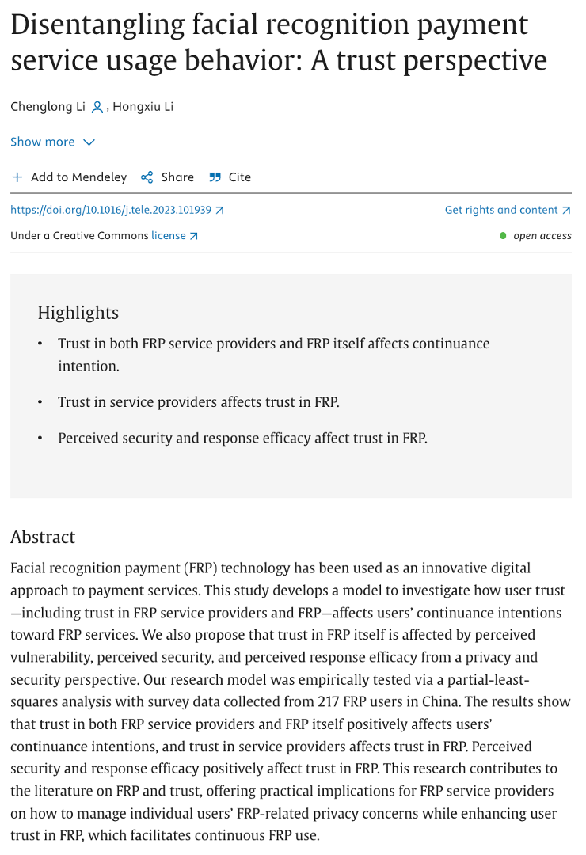
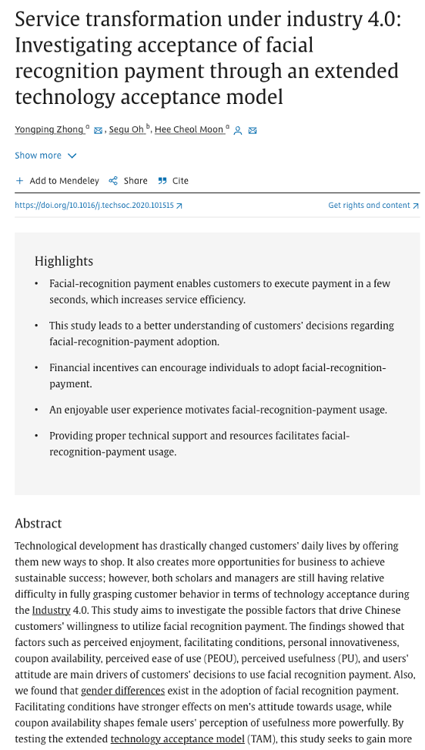
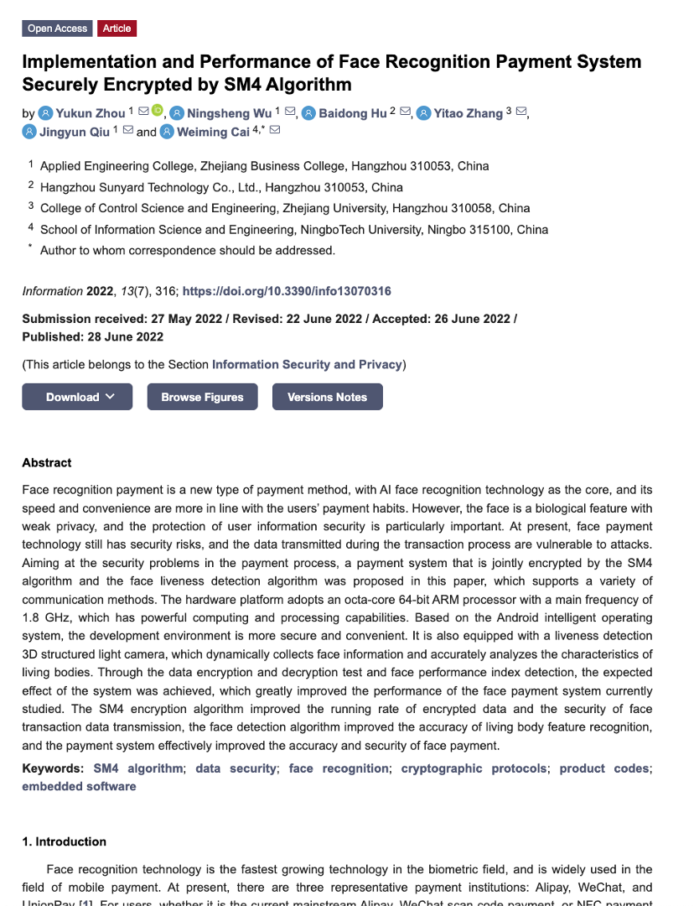
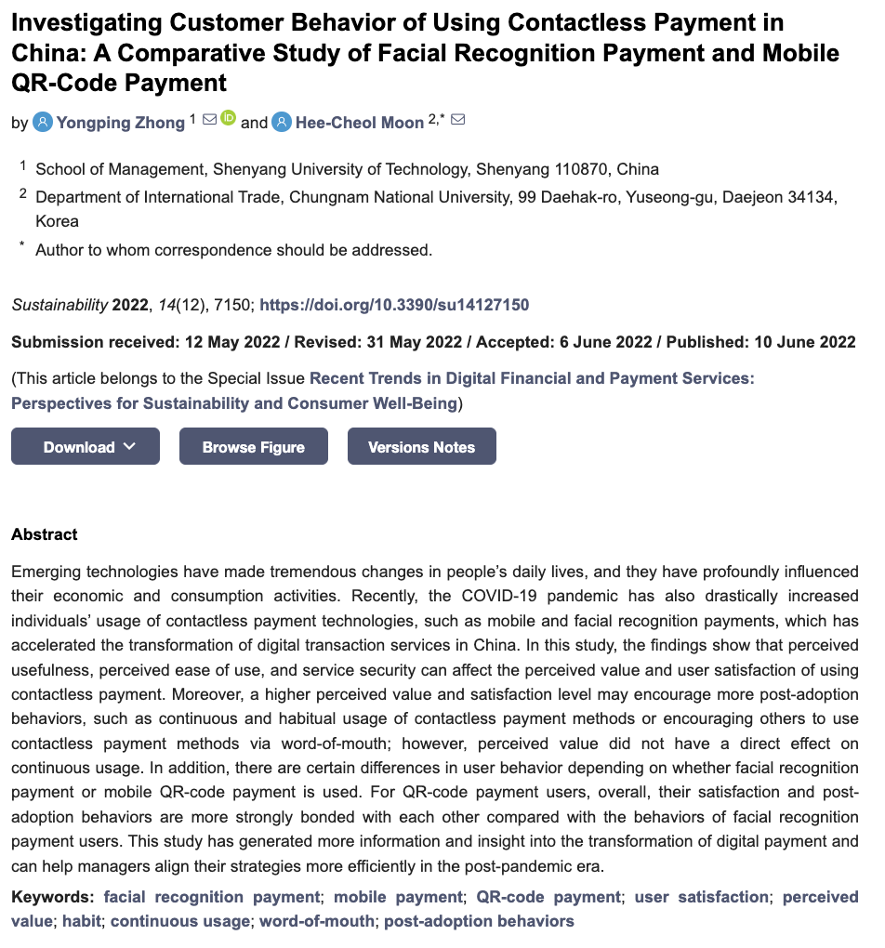
Literature Review

Slide 4




Master Card
Existing Systems.
Pay by face
Amazon
2023 came into limelight
Old generation tech far from perfect

Slide 5




Super App
Drawbacks
Exhaustive
Too many OTP’s and authentications
Old generation technology
No integration of AI
Laborous
Too much paper work
Not User-friendly
All Users are not adaptive

Slide 6


Image Acquisition
Preprocessing
Face
Detection
Feature
Extraction
Face
Database
Face
Matching
Decision
Making
User
Interface
Operation Cycle

Slide 7



Working Of The Model
ZF-Net
Early CNN with rich feature learning.
L2 Normalization
Scales vectors to unit length, preserving
directional information

Slide 8
Accuracy Of The Models
VGG 16
Face
Net
86%
94%
Accuracy
Accuracy

Slide 9


Integration of ML
01
03
02
04
Pick a model
Convert
Deploy
Optimize
Building the facial recognition model like Google face net
Convert the TensorFlow model into a compressed flat bluffer with the TensorFlow Lite converter
Take the compressed .tflite and load it into a mobile or embedded device
Quantize by converting 32-bit floats to more efficient 8-bit integers or run on gpu

Slide 10



Super App
Abstract Overview
Slay with the snap
Pay with the most powerful secured app backed by AI

Slide 11




SQL Lite
Databases
Used.
Firebase
MongoDB

Slide 12

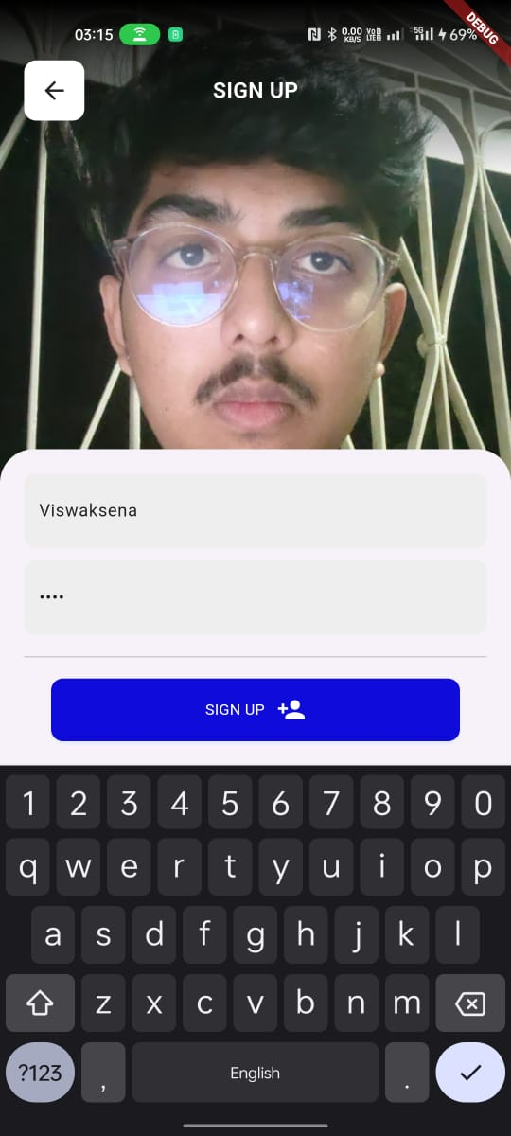
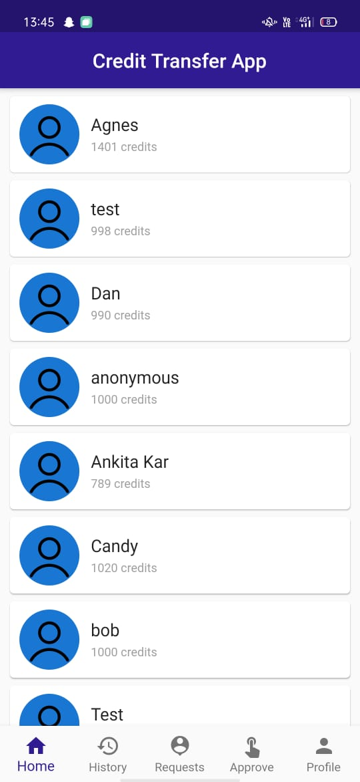
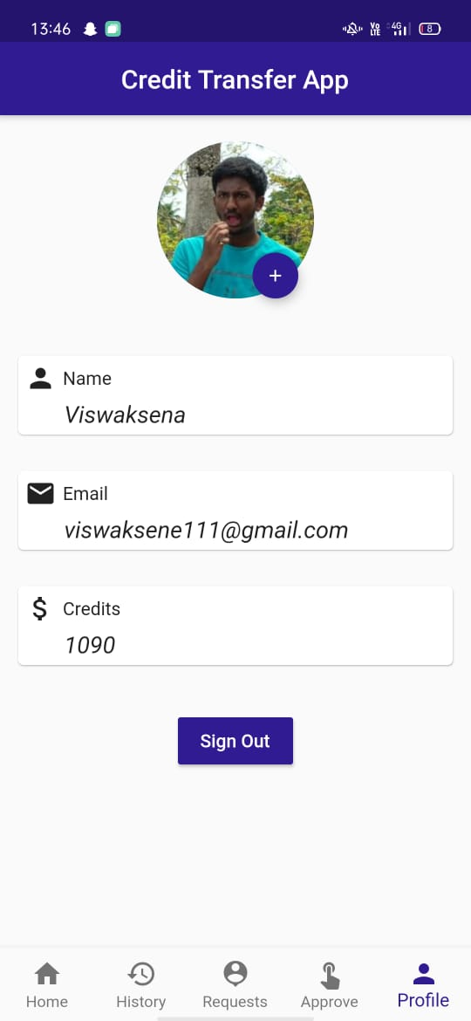
UI Screens.
Login
SignUp
Wallet
Profile

Slide 13

Wallet
Layered Blockchain
Seamless and secured transactions with the help of decentralized ledger, smart contracts, tokenization, consensus mechanisms, and audited code

Slide 14


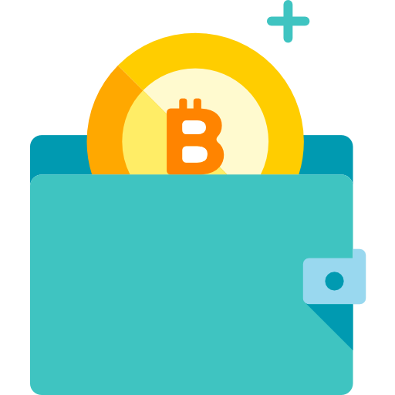
Payments
+₹2,400.77
+₹ 2,400.77
Send
Receive
+₹2,400.77
+ ₹ 2,400.77
Request
Approval

Slide 15
Conclusion
Innovative Features: The app introduces facial authentication, streamlined transactions, and contactless payments for enhanced user experience.
User-Focused Design: Prioritizing convenience, it offers a user-friendly interface, comprehensive transaction history, and caters to diverse user classes.
Security and Compliance: Emphasizes data protection, compliance with regulations, and robust user authentication for a secure and reliable digital banking

